Slide 1
Cardiovascular Embryology
Dr. Madhusudan Raikar
Dept. of Cardiology
C.M.C., Kozhikode

Slide 2
Steps in the Embryology of the Vascular System
EARLY DEVELOPMENT OF EMBRYO
ESTABLISHMENT OF THE CARDIOGENIC FIELD
FORMATION AND POSITION OF THE HEART TUBE
FORMATION OF THE CARDIAC LOOP
MOLECULAR REGULATION OF CARDIAC DEVELOPMENT
DEVELOPMENT OF THE SINUS VENOSUS
FORMATION OF THE CARDIAC SEPTAE
FORMATION OF THE CONDUCTING SYSTEM OF THE HEART
VASCULAR DEVELOPMENT

Slide 3
Early Development Of Embryo

Slide 4
Chronology of events
Day 0 – fertilization and initiation of embryogenesis
Week 1 – blastocyst formation and implantation
Week 2 – formation of bilaminar germ disc (epiblast and hypoblast)
Week3 – formation of trilaminar germ disc (gastrulation)
Mid week 3 – heart begins to form
Week 4 – cardiac looping begins
Mid week 4 – development of sinus venosus
Week 4-5 – development of cardiac septae, development of aortic arches, development of arterial and venous system begins.

Slide 5
1st week of development
Day 0 – fertilization
Day 1 – zygote formation
Day 2 – 2 cell stage (30 hrs)
Day 2 – 4 cell stage (40 hrs)
Day 3 – 16 cell stage
Day 4 – morula (32 cell stage)
Day 5 – blastocyst (inner cell mass-embryoblast and outer cell mass-trophoblast)
Day 6 – implantation

Slide 6
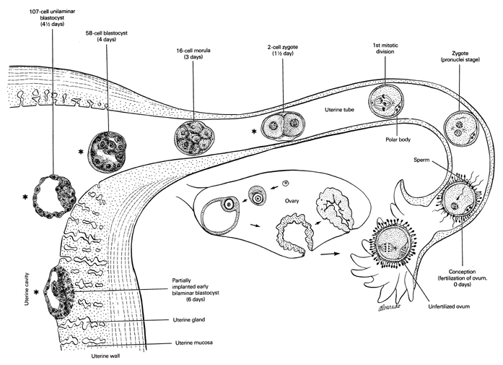

Slide 7
2nd week of development
Week of TWOs:
The trophoblast differentiates into 2 layers,
  cytotrophoblast
  Syncytiotrophoblast
The embryoblast forms 2 layers,
  epiblast
  hypoblast.
The extraembryonic mesoderm splits into 2 layers,
  Somatopleural
  splanchnopleural
2 cavities,
  amniotic cavity
  yolk sac cavity
Beginning of uteroplacental circulation

Slide 8
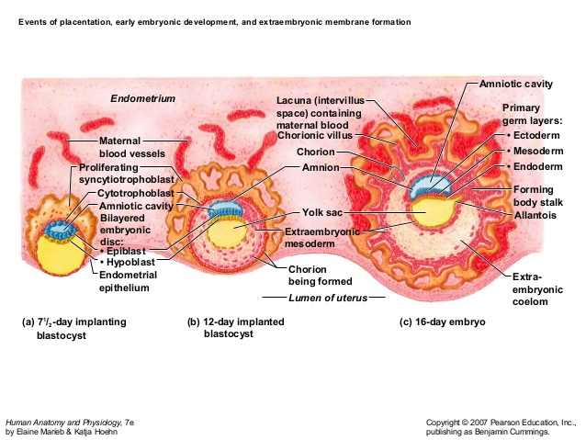

Slide 9
3rd week of development
Formation of trilaminar germ disc (Gastrulation)
  Ectoderm
  Mesoderm
  Endoderm
Appearance of primitive streak
Formation of notochord
Formation of oropharyngeal and cloacal menbrane
Establishment of body axes
Further development of trophoblast – appearance of tertiary chorionic villi

Slide 10
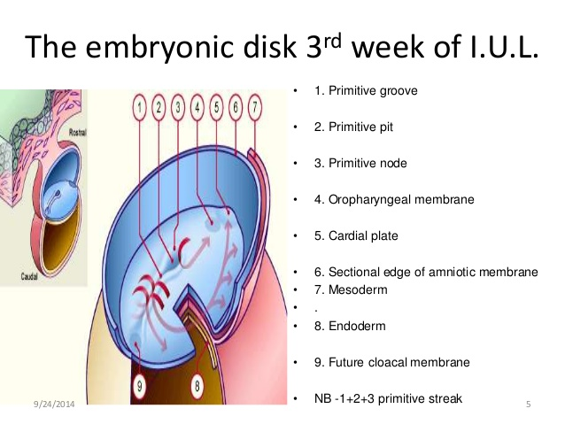

Slide 11
Cardiac Embryogenesis

Slide 12
ESTABLISHMENT OF THE CARDIOGENIC FIELD

Slide 13
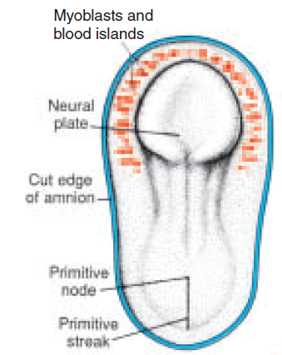
Dorsal view of a late presomite embryo (approx. 18 days) after removal of the amnion.
Human heart starts to develop in middle of 3rd week of embryonic life.
Till then, its needs are met by simple diffusion.
Cardiac progenitor cells lie in the epiblast, immediately adjacent to cranial end of primitive streak.
From there, they migrate through the streak into splanchnic layer of lateral plate mesoderm.
To form horseshoe shaped cluster of cells – primary heart field (PHF)

Slide 14
Transverse section showing position of the blood islands in splanchnic mesodermal layer.
Cells in PHF are induced by the underlying pharyngeal endoderm to form cardiac myoblasts.
With time, the islands unite and form a horseshoe-shaped endothelial-lined tube surrounded by myoblasts.
This region is known as the cardiogenic field.
Patterning of PHF occurs between 16-18 days, same time as that for the entire embryo.
PHF is specified on both sides from lateral to medial to become atria, LV and most of RV.

Slide 15
Cephalocaudal section showing the position of the pericardial cavity and cardiogenic field.
Intraembryonic cavity over cardiogenic field later develops into the pericardial cavity
In addition to the cardiogenic region, other blood islands appear bilaterally, parallel and close to the midline of the embryonic shield.
These islands form a pair of longitudinal vessels, the dorsal aortae.

Slide 16
Cardiac Precursor Cells
Derived from 4 sources :
Primary heart field (PHF)
Secondary heart field (SHF)
Cardiac neural crest cells (CNC)
Proepicardium

Slide 17
Concept of Heart Fields
2 distinct mesodermal heart fields that share a common origin appear to contribute cells to developing heart in a temporal and spatial specific manner.
Using special techniques to mark progenitor cells these 2 heart fields have been characterised.
The heart tube derived from PHF provides a scaffold that enables other cells to migrate and expand into cardiac chambers

Slide 18
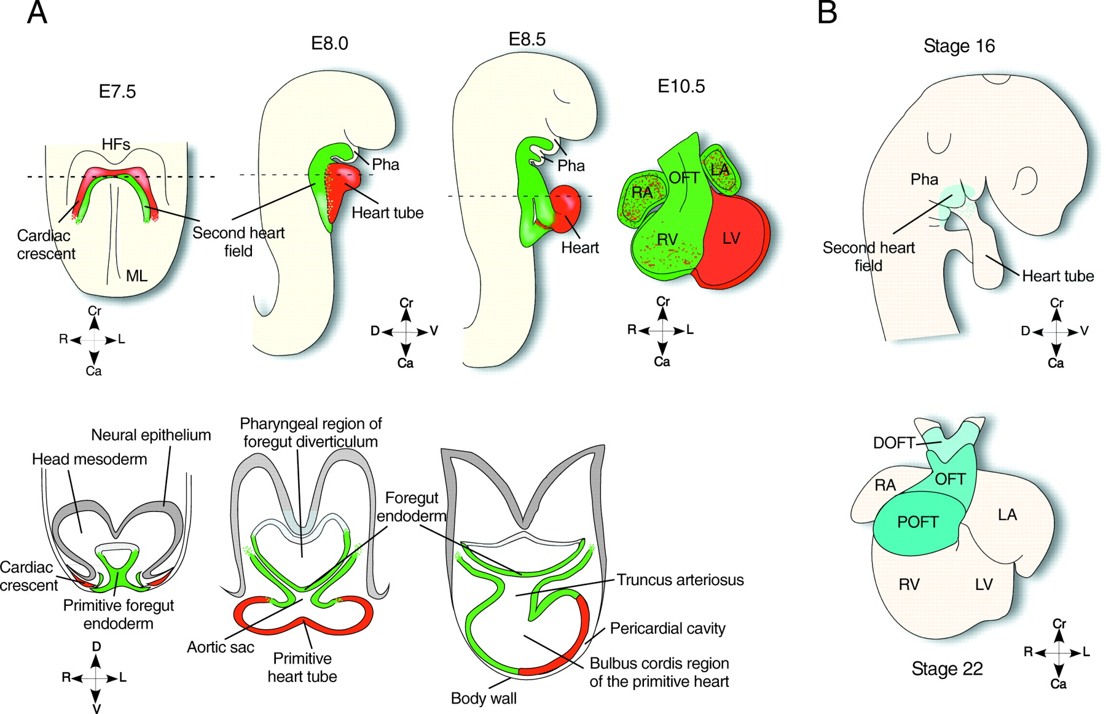
Concept of Heart Fields

Slide 19
Secondary Heart Field
Appears slightly late around days 20-21.
Resides in splanchnic mesoderm, ventral to posterior pharynx.
SHF forms part of RV and outflow tract (conus cordis and truncus arteriosus) .
Exhibits laterality, such that those on right side contribute to left outflow tract and vice versa.

Slide 20
Cardiac Neural Crest Cells
Neural crest cells, originate in the edges of the neural folds in the hindbrain region.
Migrate through pharyngeal arches 3, 4, and 6 to the outflow region of the heart and contribute to endocardial cushion formation in both the conus cordis and truncus arteriosus.
They also contribute to the formation of semilunar valves.
Also contribute smooth muscle cells along the proximal segments of coronary arteries.
Since neural crest cells also contribute to craniofacial development, it is not uncommon to see facial and cardiac abnormalities in the same individual.

Slide 21
Proepicardium
Mesothelial cells on the surface of the septum transversum form the proepicardium near the sinus venous and migrate over the heart to form most of the epicardium.
Responsible for formation of coronary arteries, including their endothelial lining and smooth muscle.

Slide 22
FORMATION AND POSITION OF THE HEART TUBE
Two processes responsible for positioning of the heart :
Folding of the embryo in a cephalocaudal direction
Folding of the embryo in a lateral direction

Slide 23
Cephalocaudal Folding
Initially, cardiogenic area is anterior to the oropharyngeal membrane and the neural plate.
Rapid cephalad growth of CNS extends it over the central cardiogenic area.
Because of cephalic folding of the embryo, the oropharyngeal membrane is pulled forward.
The heart and pericardial cavity move first to the cervical region and finally to the thorax
Figures showing effects of the rapid growth of the brain on positioning of the heart.
A. 18 days. B. 20 days. C. 21 days. D. 22 days

Slide 24
Lateral folding of the embryo
Due to lateral folding, the pair of endothelial tubes merge except at their caudalmost ends.
Simultaneously, the crescent part of the horseshoe-shaped area expands to form the future outflow tract and ventricular regions.
Thus, the heart becomes a continuous expanded tube consisting of an inner endothelial lining and an outer myocardial layer.
It receives venous drainage at its caudal pole and begins to pump blood out of the first aortic arch into the dorsal aorta at its cranial pole.

Slide 25
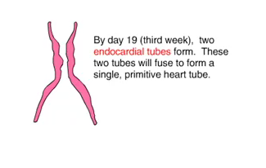
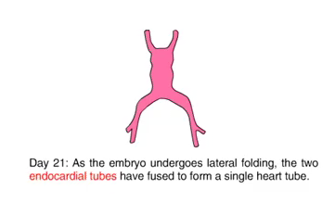
Lateral folding of the embryo
Notes:
the caudal regions of the paired cardiac primordia merge except at their
caudalmost ends. Simultaneously, the crescent part of the horseshoe-shaped
area expands to form the future outflow tract and ventricular regions. Thus, the
heart becomes a continuous expanded tube consisting of an inner endothelial
lining and an outer myocardial layer. It receives venous drainage at its caudal
pole and begins to pump blood out of the first aortic arch into the dorsal aorta
at its cranial pole

Slide 26
Development of layers of myocardium
During these events, the myocardium thickens and secretes a thick layer of extracellular matrix, rich in hyaluronic acid, that separates it from the endothelium called cardiac jelly.
In addition, mesothelial cells on the surface of the septum transversum form the proepicardium near the sinus venous and migrate over the heart to form most of the epicardium.
The remainder of the epicardium is derived from mesothelial cells originating in the outflow tract region.

Slide 27
Thus, the heart tube consists of three layers:
  Endocardium – forming the internal lining of the tube;
  Myocardium – forming the muscular wall;
  Epicardium or visceral pericardium – covering the outside of the tube.
This epicardium is responsible for formation of the coronary arteries, including their endothelial lining and smooth muscle.

Slide 28
Development of Pericardium
The developing heart tube bulges more and more into the pericardial cavity.
Initially, the tube remains attached to the dorsal side of pericardial cavity by the dorsal mesocardium.
No ventral mesocardium is ever formed.
With further development, the dorsal mesocardium disappears, creating the transverse pericardial sinus, which connects both sides of pericardial cavity.
The heart is now suspended in the cavity by blood vessels at its cranial and caudal poles

Slide 29
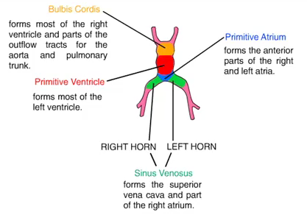
Formation of the Cardiac Loop
The heart tube starts to bend on day 23.
The cephalic portion of the tube bends ventrally, caudally, and to the right .
The atrial (caudal) portion shifts dorsocranially and to the left.
This bending creates the cardiac loop which is complete by day 28

Slide 30
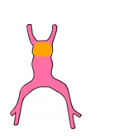
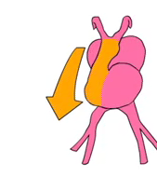

Bulbus Cordis

Slide 31
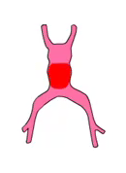
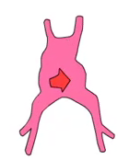
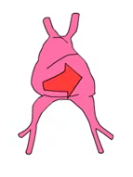
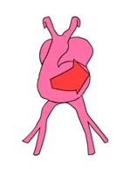
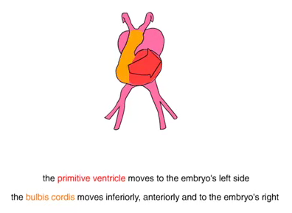
Primitive Ventricle

Slide 32
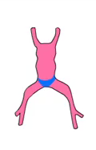
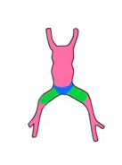
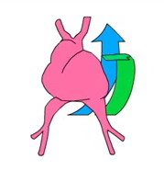
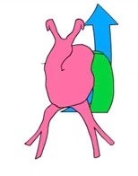
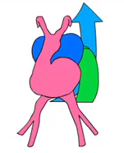
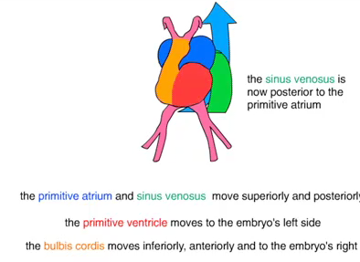
The Primitive Atrium and Sinus Venosus

Slide 33
The bulbus cordis develops 3 divisions :
  Proximal part – forms the trabeculated part of RV.
  Midportion (conus cordis) – forms the outflow tracts of both ventricles.
  Distal part (truncus arteriosus) – forms the roots and proximal portion of the aorta and pulmonary artery.
The junction between the primitive ventricle and the bulbus cordis (bulboventricular sulcus) remains narrow. It is called the primary interventricular foramen .
Evidence suggests that homeobox genes regulate organization of these segments

Slide 34
The smooth walled heart tube begins to form primitive trabeculae proximal and distal to the primary interventricular foramen.
The bulbus temporarily remains smooth walled.
The primitive ventricle, which is now trabeculated, is called the primitive LV.
Likewise, the trabeculated proximal third of the bulbus cordis may be called the primitive RV.

Slide 35
The atrial portion, initially a paired structure outside the pericardial cavity, forms a common atrium and is incorporated into the pericardial cavity.
The AV junction remains narrow and forms the AV canal, which connects the common atrium and the early embryonic ventricle
The conotruncal portion, initially on the right side, shifts gradually to a more medial position due to formation of 2 transverse dilations of the atrium, bulging on each side of the bulbus cordis .

Slide 36
Clinical correlates of abnormal cardiac looping
Dextrocardia :
Heart lies on the right side of the thorax instead of the left.
Because the heart loops to the left instead of the right.
May coincide with situs inversus

Slide 37
Molecular Regulation of Cardiac Development

Slide 38
Molecular Regulation of Cardiac Development
Anterior (cranial) endoderm induces a heart-forming region by inducing the transcription factor NKX2.5.
The signals require secretion of BMPs 2 and 4 secreted by the endoderm and lateral plate mesoderm.
Concomitantly, the activity of WNT proteins (3a and 8) secreted by the neural tube, must be blocked because they normally inhibit heart development.
Inhibitors (crescent and cerberus) of the WNT proteins are produced by endoderm cells immediately adjacent to heart-forming mesoderm.
The combination of BMP activity and WNT inhibition by crescent and cerberus causes expression of NKX2.5.

Slide 39
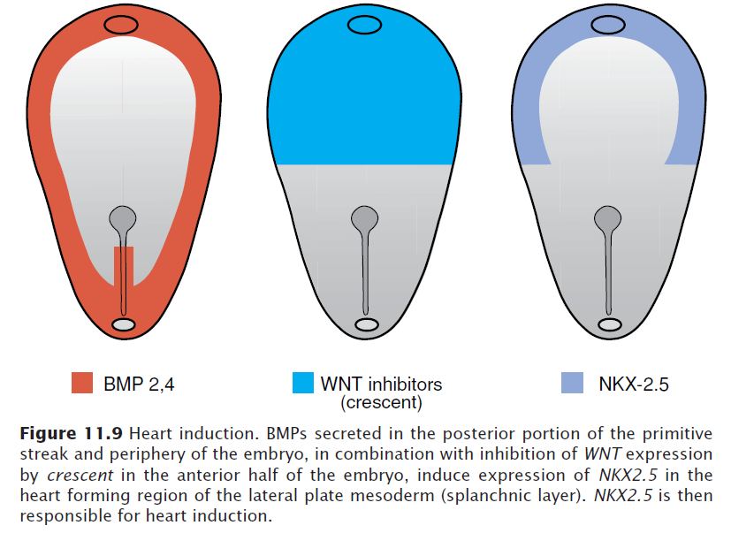
Molecular Regulation of Cardiac Development
Notes:
Signals from anterior (cranial) endoderm induce a heart-forming region in overlying
splanchnic mesoderm by turning on the transcription factor NKX2.5. The signals require secretion of bone morphogenetic proteins (BMPs) 2 and 4 and
inhibitors (crescent) of WNT genes in the endoderm and lateral plate mesoderm
(Fig. 11.9). This combination is responsible for inducing expression of
NKX2.5 that specifies the cardiogenic field and, later, plays a role in septation
and in development of the conduction system.
NKX2.5 contains a homeodomain and is a homologue of the gene tinman,
which regulates heart development in Drosophila. TBX5 is another transcription
factor that contains a DNA-binding motif known as the T-box. Expressed later
than NKX2.5, it plays a role in septation.

Slide 40
BMP upregulates expression of FGF8 that is important for the expression of cardiac-specific proteins.
Once the cardiac tube is formed, the venous portion is specified by retinoic acid (RA) produced by mesoderm adjacent to the presumptive sinus venosus and atria.
Following this initial exposure to RA, these structures express the gene for retinaldehyde dehydrogenase, which allows them to make their own RA and commits them to becoming caudal cardiac structures.
Lower concentrations of RA in more anterior cardiac regions (ventricles and outflow tract) contribute to specification of these structures.
This explains why the compound can produce a variety of cardiac defects.

Slide 41
TBX5 is another transcription factor that contains a DNA binding motif known as the T-box, plays an important role in septation.
Cardiac looping is dependent in part upon the laterality-inducing genes nodal and lefty2.
These genes induce expression of the transcription factor PITX2.
PITX2 may play a role in the deposition and function of extracellular matrix molecules during looping.
NKX2.5 upregulates expression of HAND1 and HAND2 , which are expressed in the primitive heart tube and later become restricted to the future left and right ventricles.

Slide 42
Development of the Sinus Venosus

Slide 43
Development of the Sinus Venosus
In mid 4th week, the sinus venosus receives venous blood from the right and left sinus horns.
Each horn receives blood from 3 important veins:
  vitelline or omphalomesenteric vein,
  umbilical vein,
  common cardinal vein.
Entrance of the sinus shifts to the right primarily caused by left-to-right shunts of blood occuring in the venous system.
The right horn, now the only communication between the original SV and the atrium, is incorporated into the RA.
Notes:
In the middle of the fourth week, the sinus venosus receives venous blood
from the right and left sinus horns (Fig. 11.10A). Each horn receives blood
from three important veins: (a) the vitelline or omphalomesenteric vein,
(b) the umbilical vein, and (c) the common cardinal vein. At first communication
between the sinus and the atrium is wide. Soon, however, the entrance
of the sinus shifts to the right (Fig. 11.10B). This shift is caused primarily by
left-to-right shunts of blood, which occur in the venous system during the fourth
and fifth weeks of development.
With obliteration of the right umbilical vein and the left vitelline vein during
the fifth week, the left sinus horn rapidly loses its importance (Fig. 11.10B).
When the left common cardinal vein is obliterated at 10 weeks, all that remains
of the left sinus horn is the oblique vein of the left atrium and the coronary
sinus (Fig. 11.11).

Slide 44
Development of Venous Valves
The sinuatrial orifice, is flanked on each side by a valvular fold, the right and left venous valves.
Dorsocranially, the valves fuse, forming a ridge known as the septum spurium.
The left venous valve and the septum spurium fuse with the developing atrial septum.
The superior portion of the right venous valve disappears entirely.
The inferior portion develops into two parts:
  (1) valve of the inferior vena cava
  (2) valve of the coronary sinus.
The crista terminalis forms the dividing line between the original trabeculated part of the RA and the smooth-walled part,from the right sinus horn
Notes:
As a result of left-to-right shunts of blood, the right sinus horn and veins
enlarge greatly. The right horn, which now forms the only communication
between the original sinus venosus and the atrium, is incorporated into the
right atrium to form the smooth-walled part of the right atrium (Fig. 11.12).
Its entrance, the sinuatrial orifice, is flanked on each side by a valvular fold,
the right and left venous valves (Fig. 11.12A). Dorsocranially the valves fuse,
forming a ridge known as the septum spurium (Fig. 11.12A). Initially the valves
are large, but when the right sinus horn is incorporated into the wall of the
atrium, the left venous valve and the septum spurium fuse with the developing
atrial septum (Fig. 11.12C ). The superior portion of the right venous valve
disappears entirely. The inferior portion develops into two parts: (a) the valve ofthe inferior vena cava, and (b) the valve of the coronary sinus (Fig. 11.12C ).
The crista terminalis forms the dividing line between the original trabeculated
part of the right atrium and the smooth-walled part (sinus venarum), which
originates from the right sinus horn (Fig. 11.12C ).

Slide 45
Development of the Sinus Venosus
When the left common cardinal vein is obliterated at 10 weeks, all that remains of the left sinus horn is the oblique vein of the LA and coronary sinus

Slide 46
Formation of the Cardiac Septae

Slide 47
Formation of the Cardiac Septae
The major septae are formed between the 27 and 37th days of development
It is a simultanuous process if the following areas
  Septum formation in the common atrium
  Septum formation in the atrioventricular canal
  Septum formation in the truncus arteriosus and conus cordis
  Septum formation in the ventricles

Slide 48
Septum formation in the Common Atria
At the end of the 4th week, a sickle-shaped crest grows from the roof of the
common atrium into the lumen. This crest is the first portion of the septum
primum
A. 30 days .
B. Same stage as A, viewed from the right.

Slide 49
Septum formation of the Common Atria
When the lumen of the right atrium expands as a result of incorporation of
the sinus horn, a new crescent-shaped fold appears. This new fold, the septum secundum never forms a complete partion in the atrial cavity
C. 33 days.
D. Same stage as C, viewed from the right

Slide 50
Septum formation of the common atria
When the upper part of the septum primum gradually disappears, the
remaining part becomes the valve of the oval foramen.
E. 37 days; F. Newborn.
G. The atrial septum from the right; same stage as F.

Slide 51
Further differentiation of the Atria
Primitive RA enlarges by incorporation of the right sinus horn.
From Primitive LA, a single embryonic pulmonary vein develops as an outgrowth of the posterior left atrial wall, just to the left of the septum primum.
This vein gains connection with veins of the developing lung buds.
During further development, the 4 Pulmonary Veins are incorporated, forming the large smooth walled part of the adult LA.

Slide 52
Further differentiation of the Atria
Both the wall of the right sinus horn (blue) and the pulmonary veins (red) are incorporated into the heart to form the smooth-walled parts of the atria.

Slide 53
Septum formation of the Atrioventricular Canal
At the end of the 4th week, two mesenchymal cushions, the atrioventricular endocardial cushions, appear at the superior and inferior borders of the atrioventricular canal, two additional lateral cushions appear at the left and right borders.
At the end of the 5th week there is complete fusion of the superior and inferior cushions with complete division of the canal into left and right orifices.

Slide 54
Atrioventricular Valves
After the endocardial cushions fuse, each AV orifice is surrounded by local proliferations of mesenchymal tissue.
Bloodstream hollows and thins out tissue on the ventricular surface of these proliferations, forming valves that remain attached to the ventricular wall by muscular cords.
Finally, muscular tissue in the cords degenerates and is replaced by dense connective tissue.

Slide 55
Septum formation of the Ventricles
End of the 4th week the two primitive ventricles start to expand.
The medial walls of the expanding ventricles become apposed and gradually merge, forming the muscular interventricular septum

Slide 56
Septum formation of the Truncus Arteriosus and Conus Cordis
5th week, pairs of opposing ridges appear in the truncus and conus cordis

Slide 57
Closure of Interventricular Septum
Combined Proliferations of the right and left conus cushions, along with the inferior endocardial cushion
Close the interventricular foramen and form the membranous portion of the interventricular septum.
6 weeks.
B. Beginning of the 7th week.
C. End of the 7th week.

Slide 58
Semilunar Valves
When partitioning of the truncus is almost complete, primordia of the semilunar valves become visible as pair of small tubercles found on the main truncus swellings.
One of each pair is assigned to the pulmonary and aortic channels, respectively
A third tubercle appears in both channels opposite the fused truncus swellings.
Gradually the tubercles hollow out at their upper surface, forming the semilunar valves.
Recent evidence shows that neural crest cells contribute to formation of these valves.

Slide 59
Longitudinal section through the semilunar valves
6 weeks 7 weeks 9 weeks

Slide 60
Clinical correlates
ASD related defects
ASD
Endocardial cushion defects (AV canal defects)
Tricuspid atresia

Slide 61
Clinical correlates
ASD related defects

Slide 62
Persistent common AV canal

Slide 63
Tricuspid Atresia

Slide 64
Clinical correlates
VSD related defects

Slide 65
Tetralogy of Fallot

Slide 66
Persistent truncus arteriosus

Slide 67
Transportation of the great vessels
Pulmonar valvular atresia

Slide 68
Formation of the Conducting System of the Heart
Sinu Atrial Node :
  Initially the pacemaker for the heart lies in the caudal part of the left cardiac tube.
  Later the sinus venosus assumes this function.
  As the sinus is incorporated into the right atrium, pacemaker tissue lies near the opening of the superior vena cava. Thus, the sinuatrial node is formed.
Atrio Ventricular Node and Bundle of His :
  The atrioventricular node and bundle (bundle of His) are derived from two sources:
  cells in the left wall of the sinus venosus
  cells from the AV canal.
  Once the sinus venosus is incorporated into the RA, these cells lie in their final position at the base of the interatrial septum.

Slide 69
Vascular Development
Arterial system
Venous system

Slide 70
Blood vessel development occurs by two mechanisms:
  vasculogenesis – vessels arise by coalescence of angioblasts (Eg: major vessels like Dorsal Aorta and Cardinal Veins)
  Angiogenesis – vessels sprout from existing vessels. (remainder of vascular system)
The entire system is patterned by vascular endothelial growth factor (VEGF) and other growth factors

Slide 71
Arterial System
Aortic Arches
Vitelline Arteries
Umbilical arteries

Slide 72
Aortic Arches
During 4th and 5th week
Arise from the aortic sac (truncus arteriosus ) and embedded in the mesenchyme of pharyngeal arches
Each arch receives its own cranial nerve and its own artery.
Terminate in the left and right dorsal aorta
These arches and vessels appear in a cranial to caudal sequence and
not all simultanously
The aortic sac also forms left and right horns which give rise
to the Brachiocephalic Artery and Proximal Arch respectively

Slide 73
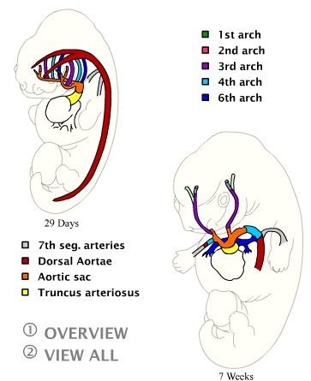
Aortic arches

Slide 74
Development of Aortic Arches
By day 27, most of the 1st aortic arch has disappeared, only a small portion persists to form the maxillary artery.
By day 29, the 2nd aortic arch also disappears, remanants are the hyoid and stapedial arteries.
The 3rd, 4th, and 6th arches are large.
The 5th aortic arch either never forms or forms incompletely and then regresses.
Once the conotruncal region divides, the 6th arches now become continuous with the pulmonary trunk.

Slide 75
The 3rd Aortic Arch :
  Forms the Common Carotid Artery (CCA) and the first part of the Internal Carotid Artery (ICA).
  The remainder of the ICA is formed by the cranial portion of the dorsal aorta.
  The External Carotid Artery (ECA) is a sprout of the 3rd aortic arch.

Slide 76
The 4th Aortic Arch :
  Persists on both sides.
  Ultimate fate is different on the right and left sides.
  On the left, forms part of the arch of the aorta, between the left CCA and the left subclavian arteries.
  On the right, forms the most proximal segment of the right subclavian artery, the distal part of which is formed by a portion of the right dorsal aorta and the 7th intersegmental artery

Slide 77
The 6th Aortic Arch :
  Also known as the Pulmonary Arch.
  On both sides, the proximal part becomes the proximal segment of the Right and Left Pulmonary Artery.
  On the right, the distal portion of this arch loses its connection with the dorsal aorta and disappears.
  On the left, the distal part persists during intrauterine life as the Ductus Arteriosus

Slide 78
Other Changes During Alterations In The Aortic Arch System:
  The dorsal aorta between the entrance of the third and fourth arches, known as the Carotid Duct, is obliterated ;
  The right dorsal aorta disappears between the origin of the 7th intersegmental artery and its junction with left dorsal aorta;
  Cephalic folding pushes heart into the thoracic cavity. Hence, the carotid and brachiocephalic arteries elongate considerably.
  The course of the Recurrent Laryngeal Nerves becomes different on the right and left sides.

Slide 79
Fate Of Recurrent Laryngeal Nerves On Both Sides
Notes:
Nerves of the 6th pharyngeal arches.
When the heart descends, they hook around the 6th aortic arches and ascend again to the larynx, which accounts for their recurrent course.
On the right, distal part of the 6th and 5th aortic arch disappear, the recurrent laryngeal nerve moves up and hooks around the right subclavian artery.
On the left, the nerve does not move up, since the distal part of the 6th aortic arch persists as the ductus arteriosus, which later forms the ligamentum arteriosum

Slide 80
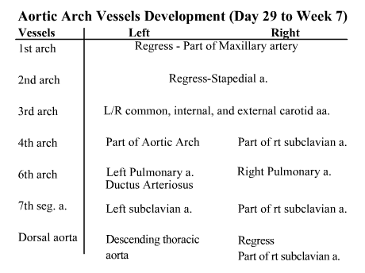
Aortic arches

Slide 81
Vitelline and Umbilical Arteries
Vitelline Arteries :
  Initially, a no. of paired vessels supplying the yolk sac .
  Gradually fuse and form the arteries in the dorsal mesentery of the gut.
  In adults, they fuse and form the Coeliac, SMA and IMA supplying foregut, midgut and hindgut respectively.
Umbilical Arteries :
  Initially paired ventral branches of the aorta
  By 4th week, they acquire a secondary connection with the aorta and forms the common iliac artery
  After birth, the proximal part persist as the internal iliac and superior vesical and the distal part obliterate to form the medial umbilical ligaments.

Slide 82
Coronary Arteries
Derived From 2 Sources:
  Angioblasts – formed elsewhere and distributed over the heart surface by migration of the proepicardial cells
  The Epicardium itself.
Some epicardial cells undergo an epithelial-to-mesenchymal transition induced by the underlying myocardium forming endothelial and smooth muscle cells of the coronary arteries.
Neural crest cells also contribute smooth muscle cells along the proximal segments of these arteries.
Connection to the aorta occurs by ingrowth of arterial endothelial cells from the arteries into the aorta.

Slide 83
Clinical correlates
Arterial system defects
Patent ductus arteriosus
Coarctation of the aorta ( preductal and post ductal)
Abnormal origin of the right subclavian artery
Right aortic arch
Interrupted aortic arch

Slide 84
Coarctation of the aorta

Slide 85
Abnormal origin of the right subclavian artery

Slide 86
Double aortic arch

Slide 87
Interrupted aortic arch

Slide 88
Venous System
In the 5th week, three pairs of major veins can be distinguished:
  Vitelline or Omphalomesenteric veins – carry blood from yolk sac to sinus venosus
  Umbilical veins – carry oxygenated blood to the embryo;
  Cardinal veins – draining the body of the embryo proper

Slide 89
Vitelline Veins
Forms a plexus around the duodenum, forms the portal vein.
Pass through the septum transversum
Hepatic cords grow into the septum and form the hepatic sinusoids
Connects to the sinus venosum

Slide 90
Vitelline Veins
Enlargement of the right vitelline vein.
Forms the hepatic cardiac part of the IVC
The SMV derives from the right vitelline vein
The left vitelline vein disappears.

Slide 91
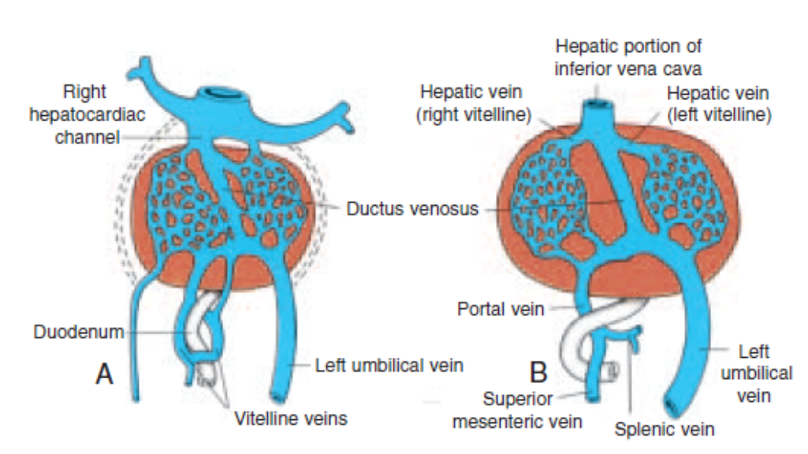
Umbilical veins
Proximal and distal right umbilical vein disappears
Proximal left umbilical vein disappears
The distal left umbilical vein remains and carry blood from the placenta to the liver
The ductus venosus form between the left umbilical vein and right hepatic cardiac channel, it bypasses the sinusoidal plexus
Both are obliterated after birth to form the ligamentum teres and ligamentum venosum .

Slide 92
Cardinal Veins
During the 4th week this forms a symmetrical system.
Anterior cardinal veins, drain the cephalic part of the embryo
Posterior cardinal veins, drain the rest of the embryo.
Both join to form Common cardinal veins.

Slide 93
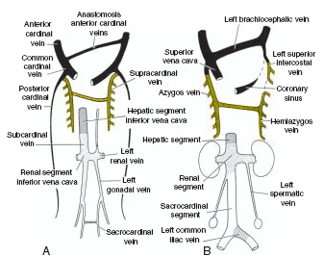
From the 5th-7th week additional veins are
formed:
Subcardinal veins, which mainly drain the kidneys;
Sacrocardinal veins, which drain the lower extremities;
Supracardinalveins, which drain the body wall by way of the intercostal veins, taking over the functions of the posterior cardinal veins

Slide 94
Clinical correlates of Venous system defects
Left superior vena cava: Persistence of the left anterior cardinal vein
Obliteration of the common cardinal and anterior
cardinal veins on the right
Double superior vena cava: Persistence of the left anterior cardinal vein
Failure of the brachiocephalic vein to form

Slide 95
Clinical correlates
Double inferior vena cava : Left sacrocardinal vein remain connected to the left subcardinal vein
Absence of the inferior cava : The right subcardinal vein fails to make the connection with the liver

Slide 96
THANK YOU

